Slide 1
ACCY577 Machine Learning for Accounting
Module 1: Introduction to Machine Learning
Linden Lu

Slide 2
Lesson 1: Introduction to Machine Learning
Artificial Intelligence, Machine Learning and Deep Learning
Machine Learning Algorithms

Slide 3
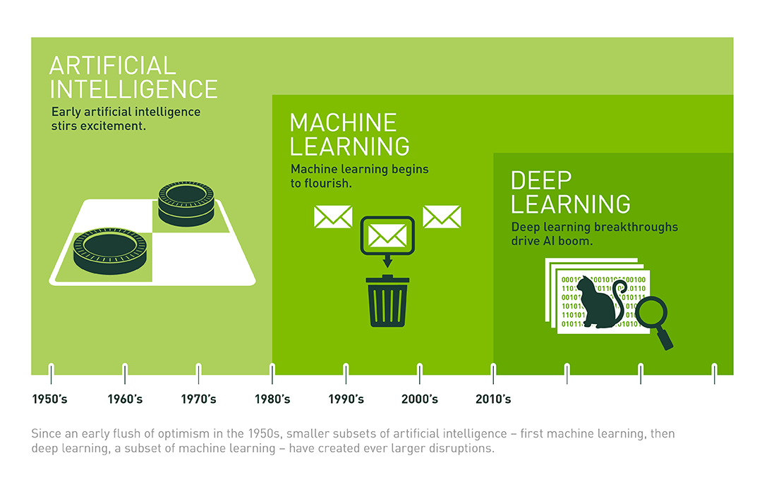
Artificial Intelligence, Machine Learning and Deep Learning

Slide 4
Machine Learning
Supervised Learning
Ground truth is available. The algorithms are provided with true outputs for a give inputs.
Classificaiton
Regression
Unsupervised Learning
No corresponding output. The algorithms identify patterns and features from the data directly.
Clustering

Slide 5
Machine Learning Algorithms
Classification
Regression
Text Analysis
Clustering
Time Sieres Analysis

Slide 6

Lesson 2: Data Pre-Processing

Slide 7
Data Pre-processing Techniques
Categorical Variables Encoding
Dataset Splitting
Data Scaling and Standardizing

Slide 8
Categorical Variables
Nominal
Categories have no numerical orders.
Gender, Color
Ordinal
Categories have numerical orders.
Rank in race, Size

Slide 9
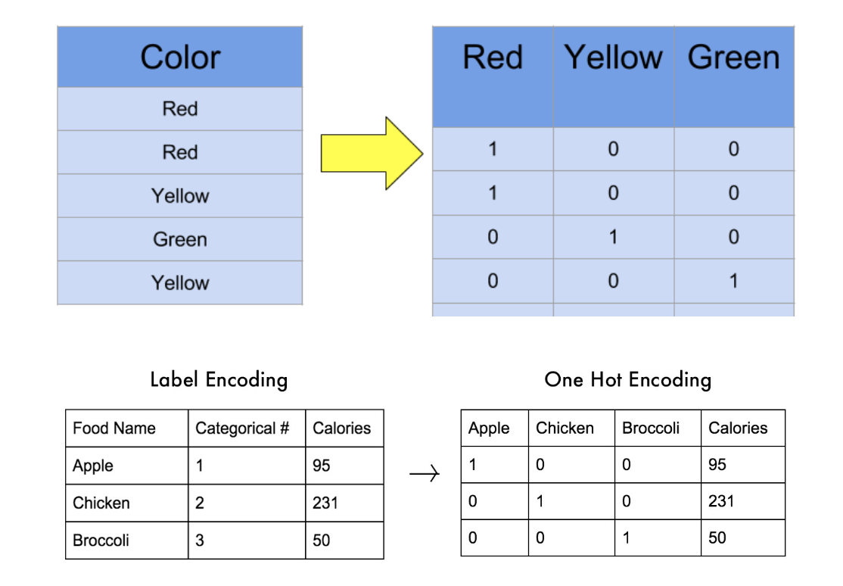
Categorical Variable Encoding
Label Encoding
Encode to unique numeric values.
One Hot Encoding
Create a dummy variable with value 0 and 1
for each category value.
Ordinal Encoding
Encode categories to ordered numerica values.
Small->0, Medium->1, Large->2

Slide 10
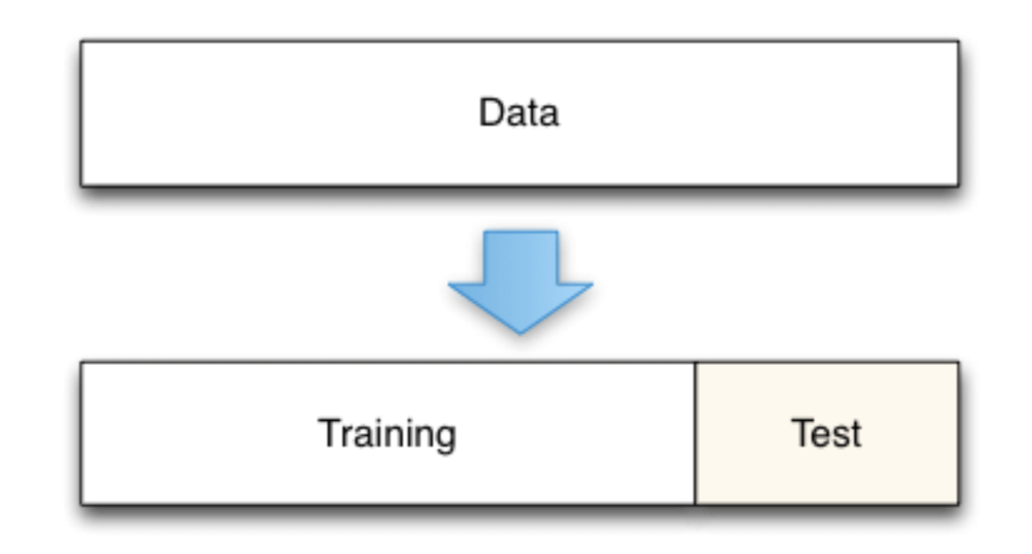
Dataset Splitting
For supervised learning
Split to training and testing set
Train model with training set
Evaluate model with testing set

Slide 11
Data Scaling
Standardizing
Zero mean and one standard deviation
Normalization
Scale to same range, normally 0 to 1

Slide 12
Lesson 3: Introduction to Machine Learning Algorithms
Modeling with Scikit-Learn
Pre-process data
Create Model
Train the model
Evaluate the model
Predict with the model

